Slide 1
NUMBER THEORY
SESSION 11-12
Course : Z0184- Discrete Mathematics
Effective Period: September 2017

Slide 2
On successful completion of this Course, students will be able to:
Learning Objectives
LO 1: Explain the logic of compound and quantified statements and how do to proof
LO 2: Explain and applying Set Theory, Counting method and Number Theory
LO 3: Explain Function, recursion, fuzzy set, Relations and Graph Theory
LO 4: Explain Trees & Graph theory and its application
LO 5: Explain Automata and graph its application in computer science

Slide 3
Number theory
1.Divisors
2.Primer Factorization
3.Congruence
4.Quadratic Residues

Slide 4
Divides
If a and b are integers with a ≠ 0, we say that
a divides b if there is an integer c so that b = ac.
When a divides b we say that a is a factor of b and that b is a multiple of a.
The notation a | b means that a divides b.
We write a X b when a does not divide b

Slide 5
Divisibility Theorems
For integers a, b, and c it is true that
if a | b and a | c, then a | (b + c)
Example: 3 | 6 and 3 | 9, so 3 | 15.
if a | b, then a | bc for all integers c
Example: 5 | 10, so 5 | 20, 5 | 30, 5 | 40, …
if a | b and b | c, then a | c
Example: 4 | 8 and 8 | 24, so 4 | 24.

Slide 6
1. Divisors
Theorem 1.1. Division Algorithm. Let n and d ≥ 1 be integers. There exist uniquely determined integers q and r such that n = qd + r and 0 ≤ r < d.
Proof. Let X = {n − td|t ∈ Z, n − td ≥ 0}. Then X is nonempty (if n≥0,then n ∈ X; if n < 0, then n(1 − d) ∈ X). Hence let r be the smallest member of X . Then r = n − qd for some q ∈ Z, and it remains to show that r < d. But if r ≥d, then 0 ≤ r − d = n − (q + 1)d, so r − d is in X contrary to the minimality of r.
As to uniqueness, suppose that n = q’d + r’, where 0≤ r’< d. We may assume that r ≤ r’(a similar argument works if r’ ≤ r). Then
0 ≤ r’ − r = (q − q’)d, so (q − q’)d is a nonnegative multiple of d that is less than d (because r’ − r ≤ r ’< d). The only possibility is
(q − q’)d = 0, so q’ = q, and hence r’ = r.

Slide 7
Given n and d ≥ 1, the integers q and r in Theorem 1.1 are called, respectively, the quotient and remainder when n is divided by d.
For example, if we divide n = −29 by d = 7, we find that −29 = (−5) · 7 + 6, so the quotient is −5 and remainder is 6.
The usual process of long division is a procedure for finding the quotient and remainder for a given n and d ≥ 1. However, they can easily be found with a calculator. For example, if n = 3196 and d = 271 then n/d = 11,79 approximately, so q = 11. Then r = n − qd = 215, so 3196 = 11 · 271 + 215, as desired.
If d and n are integers, we say that d divides n, or that d is a divisor of n, if n = qd for some integer q. We write d|n when this is the case. Thus, a positive integer p >1is prime if and only if p has no positive divisors except 1 and p. The following properties of the divisibility relation | are easily verified:

Slide 8
(i) n|n for every n.
(ii) If d|m and m|n, then d|n.
(iii) If d|n and n|d, then d = ±n.
(iv) If d|n and d|m, then d|(xm + yn) for all integers x and y.
Given positive integers m and n, an integer d is called a common
divisor of m and n if d|m and d|n.
If m and n are integers, not both zero, we say that d is the
greatest common divisor of m and n, and write d = gcd(m, n),
if the following three conditions are satisfied:
(i) d ≥ 1. (ii) d|m and d|n.
(iii) If k|m and k|n, then k|d.

Slide 9
Theorem 1.2. Let m and n be integers, not both zero. Then d = gcd(m, n) exists,and d = xm + yn for some integers x and y.
Proof. Let X = {sm + tn | s, t ∈ Z; sm + tn ≥1}. Then X is not empty since m² + n² is in X, so let d be the smallest member of X. Since d ∈ X we have d ≥ 1 and
d = xm + yn for integers x and y, proving conditions (i) and (iii) in the definition of the gcd.
Hence it remains to show that d|m and d|n.We show that d|n; the other is similar. By the division algorithm

Slide 10
write n = qd + r, where 0 ≤ r < d. Then
r = n − q(xm + yn) = (−qx)m + (1 − qy)n. Hence, if r ≥ 1, then r ∈ X, contrary to the minimality of d. So r = 0 and we have d|n.
When gcd(m, n) = xm + yn where x and y are integers, we say that gcd(m, n) is a linear combination of m and n. There is an efficient way of computing x and y using the division algorithm.
The following example illustrates the method.

Slide 11
Example . Find gcd(37, 8) and express it as a linear combination of 37 and 8.
Proof. It is clear that gcd(37, 8) = 1 because 37 is a prime; however, no linear combination is apparent. Dividing 37 by 8, and then dividing each successive divisor by the preceding remainder, gives the first set of equations.
37 = 4 · 8 +5 1= 3 − 1 · 2 = 3 − 1(5 − 1 · 3)
8 = 1 · 5 + 3 = 2 · 3 − 5 = 2(8 − 1 · 5) − 5
5 = 1 · 3 + 2 = 2 · 8 − 3 · 5 = 2 · 8 − 3(37 − 4 · 8)
3 = 1 · 2 + 1 = 14 · 8 − 3 · 37
2 = 2 · 1
The last nonzero remainder is 1, the greatest common divisor, and this turns out always to be the case. Eliminating remainders from the bottom up (as in the second set of equations) gives 1 = 14 · 8 − 3 · 37.

Slide 12
Theorem 1.3. Euclidean Algorithm. Given integers m and n ≥ 1, use the division algorithm repeatedly:
m = q₁n + r₁ 0 ≤ r₁ < n
n = q₂r₁ + r₂ 0 ≤ r₂ < r₁
r₁ = q₃r₂ + r₃ 0 ≤ r₃ < r₂
...
...
r _{k-2}= q_{k}r_{k−1} + r_{k} 0 ≤ r_{k} < r_{k-1}
r_{k−1} = q_{k+1}r_{k}
where in each equation the divisor at the preceding stage is divided by the remainder. These remainders decrease
r₁ > r₂ > · · · ≥ 0

Slide 13
so the process eventually stops when the remainder becomes zero. If r₁ = 0, then gcd(m, n) = n. Otherwise, r_{k} = gcd(m, n), where r_{k} is the last nonzero remainder and can be expressed as a linear combination of m and n by eliminating remainders.
Proof. Express r_{k} as a linear combination of m and n by eliminating remainders in the equations from the second last equation up. Hence every common
divisor of m and n divides r_{k}. But r_{k} is itself a common divisor of m and n (it divides every r_{i}—work up through the equations). Hence r_{k} = gcd(m, n).

Slide 14
Two integers m and n are called relatively prime if gcd(m, n) = 1.
Hence 12 and 35 are relatively prime, but this is not true for 12 and 15
Because gcd(12, 15) = 3. Note that 1 is relatively prime to every
integer m. The following theorem collects three basic properties of
relatively prime integers.
Theorem 1.4. If m and n are integers, not both zero:
(i) m and n are relatively prime if and only if 1 = xm + yn for some integers x and y.
(ii) If d = gcd(m, n), then m/d and n/d are relatively prime.
(iii) Suppose that m and n are relatively prime.
(a) If m|k and n|k, where k ∈ Z, then mn|k.
(b) If m|kn for some k ∈ Z, then m|k

Slide 15
Proof. (i) If 1 = xm + yn with x, y ∈ Z, then every divisor of both m and n divides 1, so must be 1 or −1. It follows that gcd(m, n) = 1. The converse is by the euclidean algorithm.
(ii). By Theorem 1.2, write d = xm + yn,
where x, y ∈ Z. Then
1 = x(m/d)+y(n/d) and (ii) follows from (i).
(iii). Write 1 = xm + yn, where x, y ∈ Z. If k = am and k = bn, a, b ∈ Z then k = kxm + kyn = (xb + ya)mn, and (a) follows. As to (b), suppose that
kn = qm, q ∈ Z. Then k = kxm + kyn = (kx + qn)m, so m|k.

Slide 16
2.Prime Factorization
Recall that an integer p is called a prime if:
(i) p ≥ 2.
(ii) The only positive divisors of p are 1 and p.
The reason for not regarding 1 as a prime is that
we want the factorization of every integer into
primes to be unique. The following result is needed.

Slide 17
Theorem 2. 1. Euclid’s Lemma. Let p denote a prime.
(i) If p|mn where m, n ∈ Z, then either p|m or p|n.
(ii) If p|m₁m₂ · · ·m_{r} where each m_{i} ∈ Z, then p|m_{i} for some i.
Proof. (i) Write d = gcd(m, p). Then d|p, so as p is a prime, either d = p or d = 1.
If d = p, then p|m; if d =1, then since p|mn, we have p|n by Theorem 1.4 .
(ii) This follows from (i) using induction on r.

Slide 18
Theorem 2.2. Every integer n >1 is a product of primes.
Proof. Let p_{n} denote the statement of the theorem. Then p₂ is clearly true.
If p₂, p₃, . . . , p_{k} are all true, consider the integer k + 1. If k + 1 is a prime, there is nothing to prove. Otherwise,
k + 1 = ab, where 2 ≤ a, b ≤ k. But then each of a and b are products of primes because p_{a} and p_{b} are both true by the
(strong) induction assumption. Hence ab = k + 1 is also a product of primes, as required.

Slide 19
Theorem 2.3. Prime Factorization Theorem. Every integer n ≥ 2 can be written as a product of (one or more) primes. Moreover, this factorization is unique except for the order of the factors. That is,
if n = p₁p₂ · · · p_{r} and n = q₁q₂ · · · q_{s} ,
where the p_{i} and q_{j} are primes, then r = s and the q_{j} can be relabeled so that p_{i} = q_{i} for each i.

Slide 20
Proof. The existence of such a factorization was shown in Theorem 2.2. To prove uniqueness, we induction the minimum of r and s. If this is 1, then n is a prime and the uniqueness follows from Euclid’s lemma. Otherwise, r ≥ 2 and s ≥ 2. Since
p₁|n = q₁q₂ · · · q_{s} Euclid’s lemma shows that p₁ divides some q_{j} , say p₁|q₁ (after possible relabeling of the q_{j} ). But then p₁ = q₁ because q₁ is a prime. Hence n/p₁ = p₂p₃ · · · p_{r} = q₂q₃ · · · q_{s} , so, by induction,
r − 1 = s − 1 and q₂, q₃, . . . , q_{s} can be relabeled such that p_{i} = q_{i} for all i = 2, 3, . . . , r. The theorem follows.

Slide 21
It follows that every integer n ≥ 2 can be written in the form n = p₁^{n}₁ p₂^{n}₂ · · · p_{r}^{n}_{r} ,where p₁, p₂, . . . , p_{r} are distinct primes, n_{i} ≥ 1 for each i, and the p_{i} and n_{i} are determined uniquely by n. If every n_{i} = 1, we say that n is square-free, while if n has only one prime divisor, we call n a prime power.If the prime factorization
n = p₁^{n}₁ p₂^{n}₂ · · · p_{r}^{n}_{r} of an integer n is given, and if d
is a positive divisor of n, then these p_{i} are the only possible prime divisors of d (by Euclid’s lemma). It follows that

Slide 22
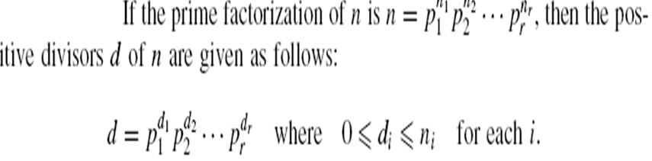
Prime Factorization
Collorary 2.4

Slide 23
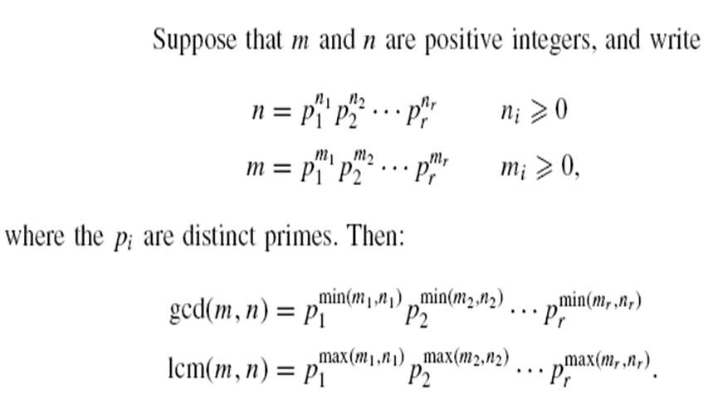
Prime Factorization
Theorem 2.5

Slide 24
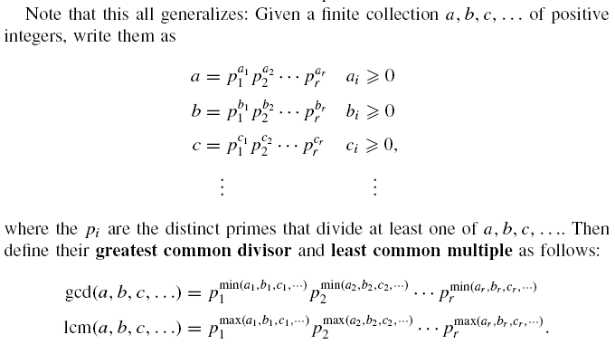

Slide 25
3.Congruences
Definition 3.1.. If m ≥ 0 is fixed, then integers a and b are congruent modulo m,denoted by a ≡ b (mod m)
if m | (a – b ). Usually, one assumes that the modulus
m >1 because the cases m = 0 and m = 1 are not very interesting: if a and b are integers, then a ≡ b (mod 0) if and only if 0 | (a –b), that is, a = b, and so congruence mod 0 is ordinary equality.
The congruence a ≡ b (mod 1) is true for every pair of integers a and b because 1 | (a – b) always. Hence, every two integers are congruent mod 1.

Slide 26
If a and b are positive integers, then a ≡ b (mod 10) if and only if they have the same last digit; more generally, a ≡ b (mod 10^{n} )if and only if they have same last n digits. For example, 526 ≡ 1926 (mod 100).
London time is 6 hours later than Chicago time. What time is it in London if it is 10:00 A.M. in Chicago? Since clocks are set up with 12 hour cycles, this is
really a problem about congruence mod 12. To solve it, note that 10 + 6 = 16 ≡ 4(mod 12); and so it is 4:00 P.M. in London.

Slide 27
Proposition 3.1. If m > 0 is a fixed integer, then for all integers a, b, c,
(i) a ≡ a (mod m);
(ii) if a ≡ b (mod m), then b ≡ a (mod m);
(iii) if a ≡ b (mod m) and b ≡ c (mod m), then a ≡ c (mod m).
Proposition 3.2. Let m > 0 be a fixed integer.
(i) If a = qm + r , then a ≡ r (mod m).
(ii) If 0 ≤ r ’< r < m, then r and r ’are not congruent mod m; in symbols, r r ’ (mod m).
(iii) a ≡ b (mod m) if and only if a and b leave the same remainder after dividing by m.

Slide 28
Proposition 3.3. Let m> 0 be a fixed integer.
(i) If a_{i} ≡ a’_{i} (mod m) for i = 1; 2; … ; n, then
a₁ +... + a_{n} ≡ a’₁ +...+ a’_{n} (mod m):
In particular, if a ≡ a’ (mod m) and b ≡ b’ (mod m), then
a + b ≡ a’ + b’ (mod m):
(ii) If a_{i} ≡ a’_{i} (mod m) for i = 1; 2; … ; n, then
a₁ ... a_{n} ≡ a’₁ ... a'_{n} (mod m)
In particular, if a ≡ a’ (mod m) and b ≡ b’ (mod m), then ab ≡ a’b’ (mod m)
(iii) If a ≡ b (mod m), then a^{n} ≡ b^{n} (mod m) for all n >0.

Slide 29
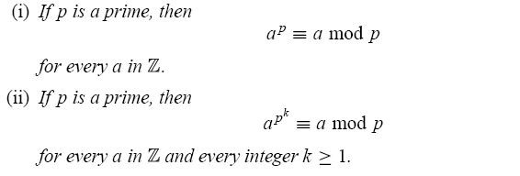
Theorem 3.4 (Fermat).

Slide 30
Theorem 3.5. If (a;m)= 1, then, for every integer b, the congruence ax ≡ b (mod m) can be solved for x; in fact,
x = sb, where sa ≡ 1 (mod m). Moreover, any two solutions are congruent mod m.
Proof. Since (a;m)= 1, there is an integer s with
as ≡ 1( mod m) (because there is a linear combination
1 = sa + tm). It follows that b = sab + tmb and
asb ≡ b (mod m), so that x = sb is a solution. (Note that Proposition 3.2(i) allows us to take s with 1≤ s < m.)
If y is another solution, then ax ≡ ay mod m, and so
m | a(x - y). Since (a;m)= 1, Theorem 1.4 gives m |(x – y); that is, x ≡ y (mod m).

Slide 31
4.Quadratic Residues
Definition 4.1. If m is a positive integer ,we say that the integer a is a quadratic residue of m if (a,m) = 1 and the congruence x² ≡ a (mod m) has a solution.
If the congruence x² ≡ a (mod m) has a no solution, we say a is quadratic nonresidue of m.
Example. To detemine which integer are quadratic residues of 11, we compute the squares of the integer 1, 2, 3, …, 10.We find that 1² ≡ 10² ≡ 1(mod 11), 2² ≡ 9² ≡ 4 (mod 11), 3² ≡ 8² ≡ 9 (mod 11), 4² ≡ 7² ≡ 5 (mod 11), and 5² ≡ 6² ≡ 3(mod11).
Hence , the quadratic residues of 11 are 1, 3, 4, 5, 9 ;the integer 2,6,7,8,10 are quadratic nonresidues of 11.

Slide 32


Lemma 4.1. Let p be odd prime and a an integer not divisible by p. Then the congruence x² ≡ a (mod p) has either no solutions or exactly two incongruent solutions modulo p.
Proof. If x² ≡ a (mod p ) has a solution, say x = x₀, then we can easily demonstrate that x = - x₀ is second incongruent solution. Since (-x₀)² = x₀² ≡ a (mod p ) we see that – x₀ is solution. We note that x₀ –x₀ (mod p), for if x₀ ≡ - x₀ (mod p), then we have 2x₀ ≡ 0 (mod p). This is impossible since p is odd and p x₀ (since x₀² ≡ a (mod p ) and p a ).
To show that there are no more than two incogruent solutions,
assume that x ≡ x₀ and x ≡ x₁ are both solutions of x² ≡ a (mod p). Then we have x₀² ≡ x₁² ≡ a (mod p) , so that

Slide 33
x₀²- x₁² = (x₀ + x₁)(x₀- x₁) ≡ 0 (mod p).
Hence , p| (x₀ +x₁) or p | (x₀- x₁), so that x₁ ≡ - x₀ (mod p) or
x₀ ≡ x₁ (mod p). Therefore if there is a solution of x² ≡ a (mod p), there are exactly two incongruent solution.
Theorem 4.2. If p is an odd prime , then there are exactly
(p-1 )/2 quadratic residues of p and ( p – 1 )/2 quadratic nonresidues of p among the integer 1, 2, …, p – 1 .
Proof. To find all the quadratic residues of p among the integers 1, 2, …, p – 1 we compute the least positive residues modulo p of the squares of the integers 1, 2, p – 1 .

Slide 34
Since there are p – 1 squares to consider and since each congruence x² ≡ a (mod p) has either zero or two solotions , there must be exactly ( p – 1 )/2 quadratic residues of p among the integer 1, 2, …, p – 1 . The remaining p – 1 – ( p – 1 )/2
= ( p – 1 )/2 positive integers less than p – 1 are quadratic nonresidues of p .
The special notation associaed with quadratic residues is described in the following definition.

Slide 35
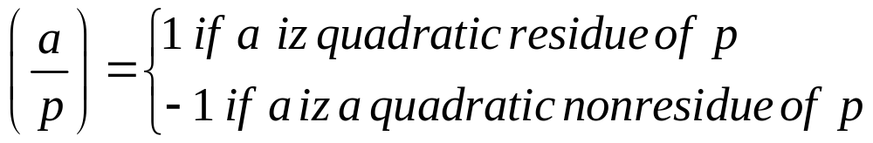
Definition 4.2. Let p be an odd prime and a an integer not divisible by p . The Legendre symbol is defined by
The symbol iz named after the French mathematician Andrien – Marie Legendre who introduced the use of this notation

Slide 36
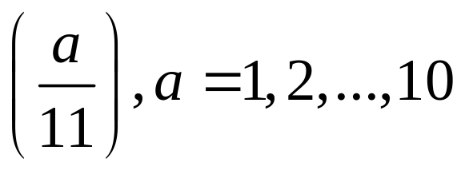
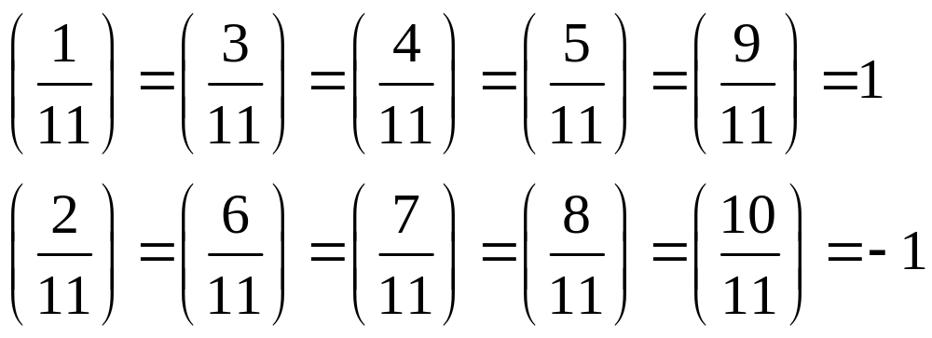
Example . The previous example shows that the Legendre symbol
have the followings values :

Slide 37
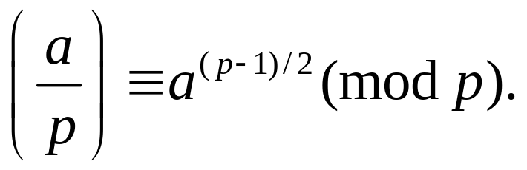
We now present a criterion for deciding whether an integer is a quadratic residue of prime. This criterion is useful in demonstraing propeties of the Legendre symbol.
Theorem 4.3. Euler’s Criterion.
Let p be an odd prime and let a be positive integer not divisible by p. Then

Slide 38
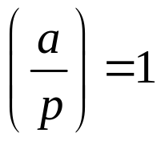
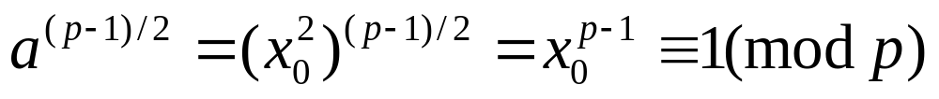
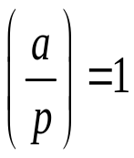
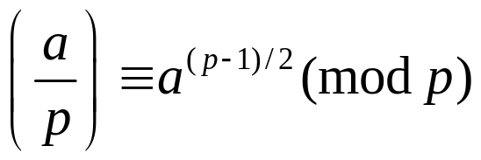
Proof.
Firt ,assume that .Then , the congruence x² ≡ a (mod p)
has a solution, say x = x₀. Using Fermat’s little theorem , we see
that
Hence,if ,we know that

Slide 39
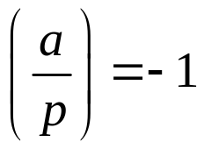

Now cosider the case where .Then , the congruence
x² ≡ a (mod p) has no solutions. For each integer i such that
1≤i≤p-1, there is a unique integer j with 1≤j≤p-1, such that
ij ≡ a (mod p ). Furthermore , since the congruence x² ≡ a
(mod p) has no solutions, we know that i≠j. Thus, we can
group the integer 1, 2,…, p - 1 into (p – 1 )/2 pairs each with
product a . Multiplying these pairs together, we find that
(p – 1 )! ≡ a ^{(p – 1 )/2} (mod p).Since Wilson’s theorem tell us that
(p – 1 )!≡ - 1 (mod p), we see that – 1 ≡ a ^{(p -1 )/2} (mod p) .In this
case, we also have

Slide 40
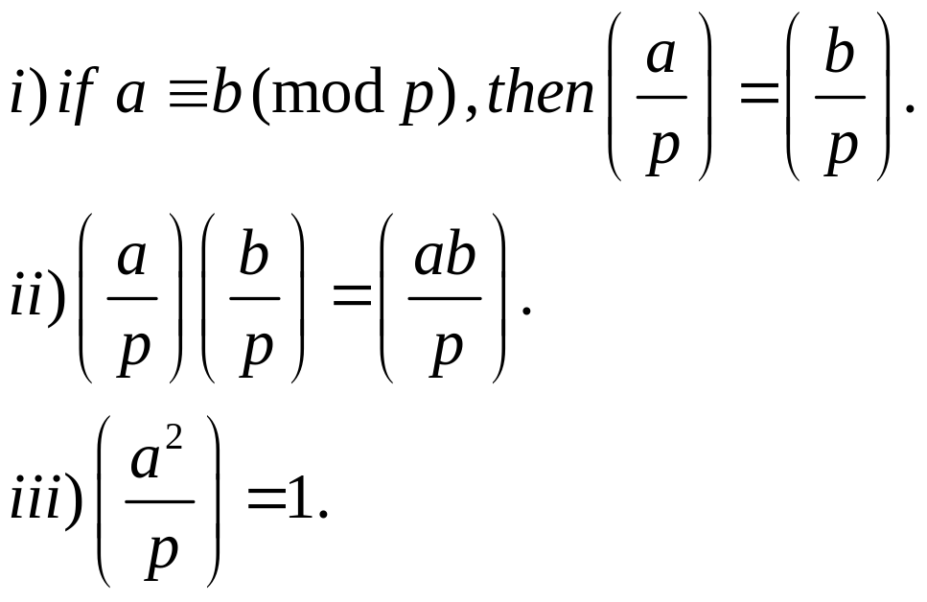
Theorem 4.4. Let p be an odd prime and a and b integers not
divisible by p.Then

Slide 41
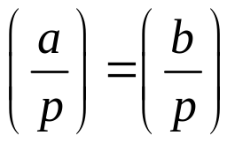
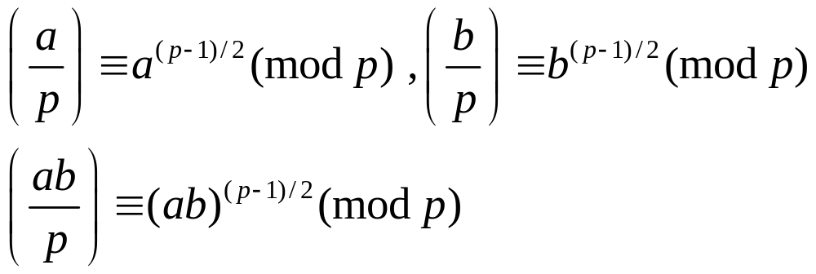
Proof.
If a ≡ b (mod p ) then x² ≡ a (mod p) has s solution if an
only if x² ≡ b (mod p) has solution.Hence .
By Euler’s criterion we know that

Slide 42
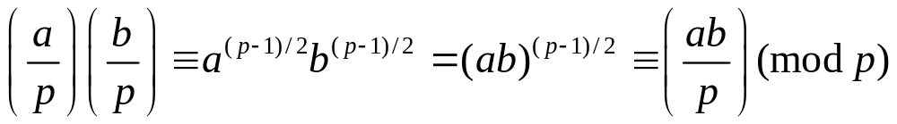
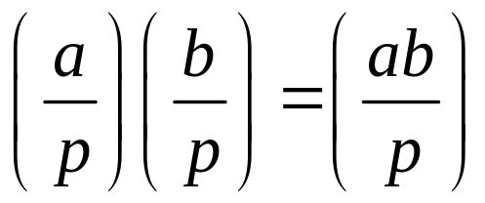
Hence ,
Since the only posible values of a Lagendre symbol are ±1, we
conclude that

Slide 43
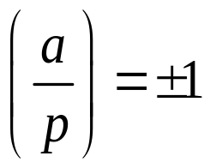
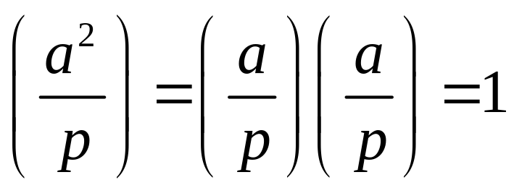
iii) Since , from part (ii) it folows that

Slide 44
Reference
Susanna S.Epp. (2015). Discrete Mathematics with Applications.5th edition. Thomson Brooks/Cole. USA. ISBN: 9780534359454

